Slide 1

Consumer Cost Impact of
Kigali Ratification & Implementation
December 7, 2018

Slide 2
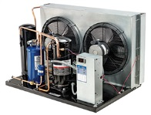


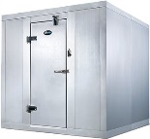
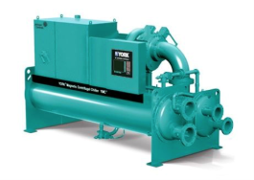

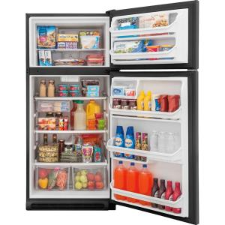
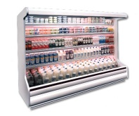
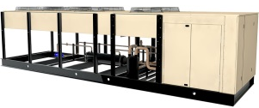
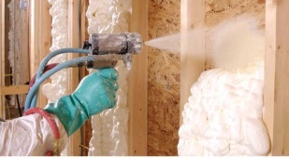
US Industry Segments (Fluorocarbons)
Fluorocarbons are used in commercial HVAC, residential HVAC, commercial refrigeration, household appliances, and motor vehicle air conditioning
Insulating foams, medical metered-dose inhalers, aerosols, and several other applications make up the remainder of the manufacturing sector
American-made products that preserve the health, safety and comfort of our daily lives

Slide 3
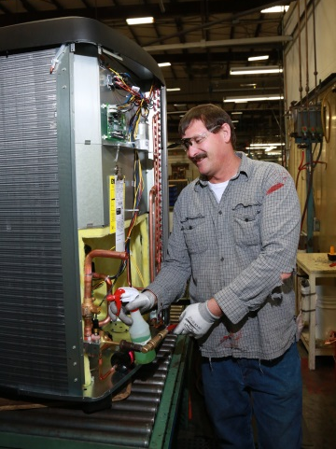
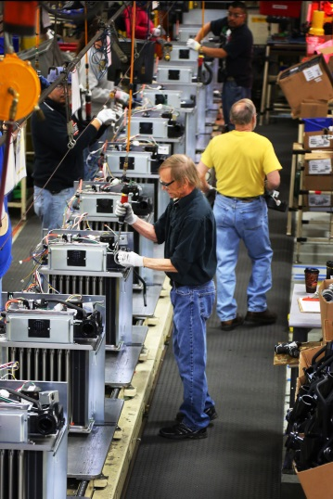
US Industry Objective
US industry strongly supports ratification of Kigali Amendment to the Montreal Protocol and domestic implementation.
Heating Ventilation Air Conditioning and Refrigeration (HVACR) and Fluorocarbon technologies are signature American technologies.
The Kigali Amendment provides a global platform for gradual introduction and commercialization of next generation technologies in the US and in the rapidly expanding global market.
Analysis indicates that implementation of the Kigali Amendment is good for American Jobs, the balance of trade and continued American technology leadership.
Life-cycle cost analysis of the air conditioning industry shows the transition under Kigali is expected to reduce consumer costs.
We urge the Administration to submit the Kigali Amendment to the US Senate

Slide 4
Key Consumer Costs Continue to Decline
Historical & Projected Real Price Indices for U.S. Major Appliance Categories
The 30-year history of the Montreal Protocol shows the industry has used innovations, new technologies, and more sustainable compounds to drive continued reduction of consumer costs.
Industry innovation, gradual transition schedules, and avoiding impacts on existing equipment owners allowed the industry to accommodate major transition costs over time, minimizing impact on consumer prices.
Most U.S. major appliance prices have declined over time and are expected to continue to do so.
Room air conditioners, refrigerators, and central air conditioners have all seen real price declines despite major technology transitions under the Montreal Protocol.
See Desroches, et al. (2018). Historical trends based on the PPI published by the U.S. Bureau of Labor Statistics. Projected trends are experience curve fits to the historical data.
Innovation and planning minimized costs of conversion under the Montreal Protocol.

Slide 5
Life-Cycle Costs of Air Conditioning
Electricity dominates lifetime costs for both residential and commercial air conditioning.
Refrigerant Supply is less than 1% of lifetime costs.
Cost projections of each element were made for a new equipment purchase in 2029, with and without Kigali ratification.
Energy cost dominates even equipment cost, and refrigerant is a minor contributor.

Slide 6
Consumers Benefit from Kigali
Total costs were estimated over 15-year lifetime for average 2.5 ton residential and 15 ton commercial air conditioning units.
Equipment with Kigali is conservatively assumed to be 10% more costly, but on average slightly more efficient, with lower leak rates and smaller charge sizes.
The average price among all refrigerants is expected to equilibrate and continue to average ~$7/lb.
Driven by energy, total costs decline slightly with Kigali. There are no significant consumer cost impacts even if refrigerant prices were 5x higher.
Total Cost of Ownership for 2029 Purchase
Kigali will not increase consumers’ cost of air conditioning.

Slide 7
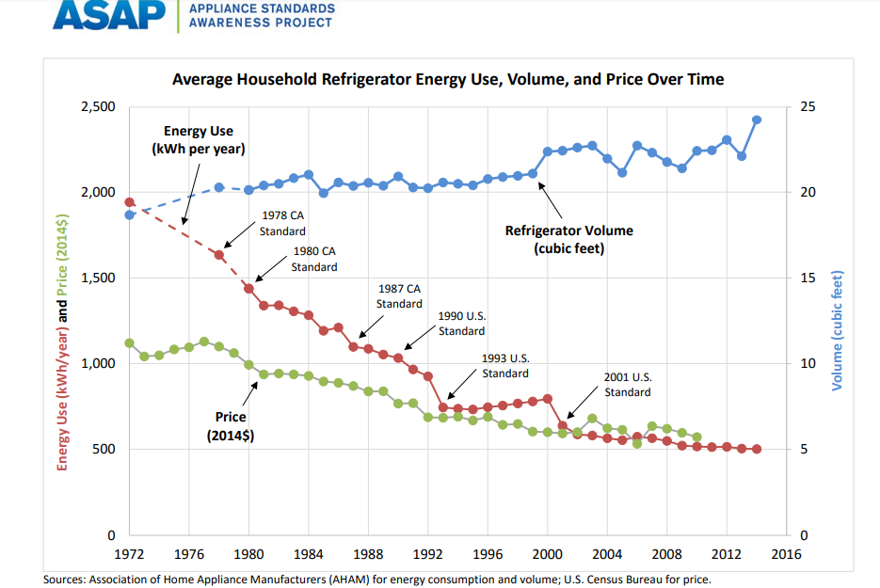
Refrigerators Add Value at Lower Cost
Refrigerators today are larger, lower-priced, and more energy-efficient than ever.
The trend has been persistent despite 30 years of transitions under the Montreal Protocol.
Similarly, other applications have already begun to transition to new compounds and can benefit further from the clarity of the Kigali schedule.
There is no reason to expect consumer impacts of Kigali to differ from earlier transitions.

Slide 8
Kigali Ratification Impact
2027
Manufacturing Jobs
  Current manufacturing impact is 138.4K jobs
  Kigali ratification increases direct manufacturing jobs by 33K
  Manufacturing growth translates into an incremental 150K jobs economy-wide
Direct Economic Output
  Kigali ratification improves direct manufacturing output by $12.5B
  Total increased output of $38.8B versus no ratification scenario
Trade Balance
  Positive impact on balance of trade
  Manufacturing impacted directly
Direct increase 33K Manufacturing jobs w/ Kigali ratification
Kigali Amendment ratification essential to jobs growth, industry growth, trade balance.

Slide 9
Economic Analysis Background
Inforum and JMS Consulting previously assessed industry size and conducted scenario analysis, focusing on HVACR, the largest segment.
Analysis extended to consider consumer costs in residential and commercial air conditioning, the largest segments.
Analysis based on public data and industry interviews
Assumptions are consistently conservative relative to the range of data gathered.

